Slide 1

Object Detection
Learning Objectives:
Identify the components used for object detection (landmark, anchor, bounding box, grid, ...) and their purpose
Implement object detection
Implement non-max suppression to increase accuracy
Implement intersection over union
Handle bounding boxes, a type of image annotation popular in deep learning
Apply sparse categorical crossentropy for pixelwise prediction
Implement semantic image segmentation on the CARLA self-driving car dataset
Explain the difference between a regular CNN and a U-net

Slide 2
Object Detection
1 Object localization Object localization
2 Landmark detection
3 Object detection
4 Convolutional implementation of sliding windows
5 Bounding box predictions
6 Intersection over union
7 Non-max suppression
8 Anchor boxes
9 Region proposals (Optional)
10 Putting it together: YOLO algorithm
11 Semantic segmentation with U-Net

Slide 3
Object Detection
Object localization

Slide 4
Object localization
Object detection, a subfield of computer vision, involves identifying and localizing objects in an image.
- The process begins with object localization, where the algorithm not only identifies but also draws bounding boxes around objects.
Unlike image classification, which identifies a single object, object detection handles multiple objects of different categories in a single image.
Modification for classification with localization requires the neural network to output four additional parameters for bounding box localization.
The target label includes object class and bounding box parameters. Training utilizes a squared error loss function.
This approach of outputting real numbers for localization extends to various areas in computer vision.
Notes:
The section will cover object detection, which is a subfield of computer vision that involves identifying and localizing objects within an image.
- The first step in this process is object localization, where the algorithm not only identifies the object but also draws a bounding box around its location.
- While image classification (where the algorithm identifies an object without specifying its location) has been around for some time, object detection is a newer and rapidly developing field.
The difference between classification with localization and object detection:
- Classification with localization is typically used when there is only one object in an image that needs to be identified and localized.
- Object detection, on the other hand, involves detecting and localizing multiple objects within a single image, often of different categories.
To accomplish classification with localization, the neural network must be modified to output four additional numbers that parameterize the bounding box of the detected object. The target label y for this supervised learning task includes not only the object class label but also the four parameters that specify the bounding box. If there is no object in the image, the target label y will have a pc (probability of an object) value of 0 and the other components will be don't cares.
The loss function used to train the neural network is typically a squared error loss, where the loss is the sum of the squares of the difference between the predicted and actual output values for all eight components if pc=1. If pc=0, then the loss is just the squared difference between the predicted and actual output for pc.
Having the neural network output a set of real numbers to localize objects is a powerful idea that can be applied in many other areas of computer vision.

Slide 5
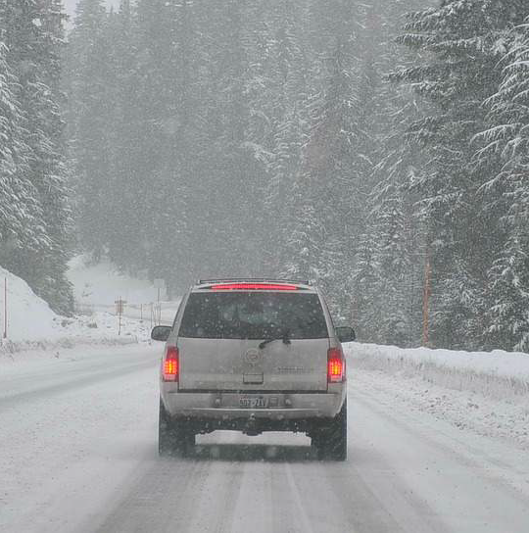
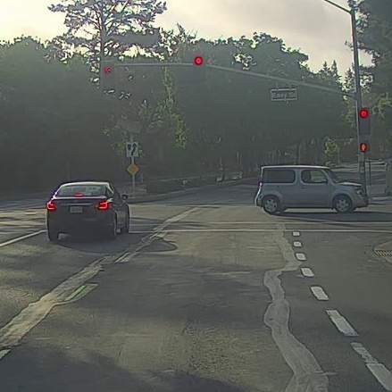
What are localization and detection?
Classification with localization
Image classification
Detection

Slide 6



Classification with localization
⋯
⋮
bouding box
- pedestrian
- car
- motorcycle
- background

Slide 7
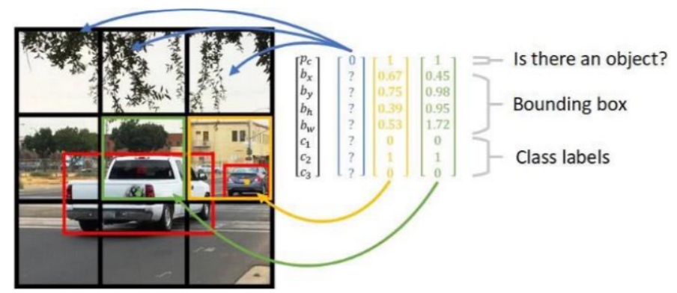
Defining the target label y
- pedestrian
- car
- motorcycle
- background

Slide 8
Object Detection
Landmark detection

Slide 9
Landmark detection
Landmark detection in computer vision identifies key points on an object or image, such as facial features for expressions.
A neural network is trained to output X and Y coordinates for each landmark, with varying numbers depending on the application.
Training requires a labeled set with consistent coordinates for each point across images.
Once trained, the network detects landmarks in new images, applied in face recognition, pose detection, and augmented reality effects.
Additionally, landmark detection enhances object detection accuracy by providing shape and position information.
Notes:
Landmark detection is a technique used in computer vision to recognize and locate key points or landmarks on an object or image. In the case of facial landmark detection, the key points are typically features such as the corners of the eyes, the tip of the nose, and the edges of the mouth, which can be used to recognize facial expressions and emotions.
In order to perform landmark detection, a neural network is trained to output the X and Y coordinates of each landmark point. The number of landmarks can vary depending on the application and can range from just a few points to several dozen.
To train a neural network for landmark detection, a labeled training set is needed. In this set, each image is labeled with the coordinates of each landmark point. The labels must be consistent across different images, meaning that the same point must always have the same label in every image.
Once the neural network is trained, it can be used to detect the landmarks on new images. This technique is used in a variety of applications, including face recognition, pose detection, and special effects in augmented reality.
Landmark detection is also an important building block for object detection. In object detection, a neural network is trained to not only recognize the presence of an object in an image but also to localize it by predicting its bounding box. Landmark detection can be used to improve the accuracy of object detection by providing additional information about the object's shape and position.

Slide 10


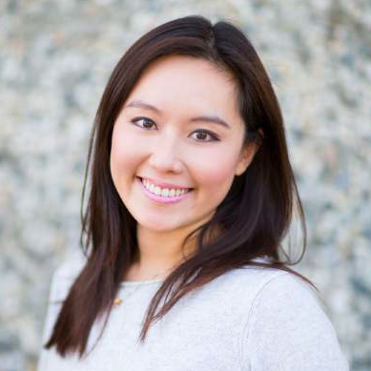
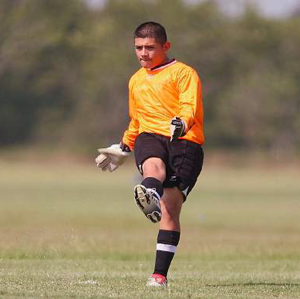
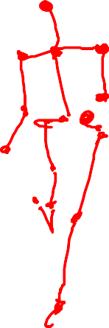

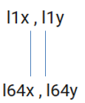

Landmark detection
ConvNet

Slide 11
Object Detection
Object detection

Slide 12
Object detection
The Sliding Windows Detection Algorithm utilizes a ConvNet for object detection. It involves creating a labeled training set, training the ConvNet to detect the object's presence, and using sliding windows to pass rectangular regions of an input image into the ConvNet for classification.
The algorithm divides the test image into fixed-sized rectangular regions, shifting them with a fixed stride to cover the entire image. Windows of increasing sizes detect objects of different scales.
However, the algorithm's computational cost is high due to processing numerous regions, particularly challenging with a ConvNet.
Notes:
The Sliding Windows Detection Algorithm is a way to perform object detection using a ConvNet. The algorithm involves creating a label training set with closely cropped examples of the object you want to detect, training a ConvNet to output whether there is an object present or not, and then using sliding windows to pass small rectangular regions of an input image into the ConvNet and classify them as containing the object or not.
The Sliding Windows Detection Algorithm involves dividing the test image into small rectangular regions of a fixed size and feeding each region into the ConvNet to make a prediction. The regions are then shifted by a fixed stride, and the process is repeated until the entire image is covered. This is done with windows of increasing sizes to detect objects of different scales. The hope is that if there is a car somewhere in the image, there will be a region where the ConvNet outputs a positive prediction.
However, the Sliding Windows Detection Algorithm has a significant computational cost because of the large number of regions that need to be processed. This becomes more challenging with the use of a ConvNet since each classification task is more expensive.

Slide 13
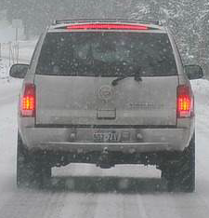
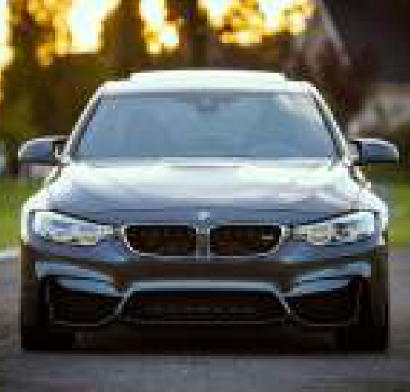
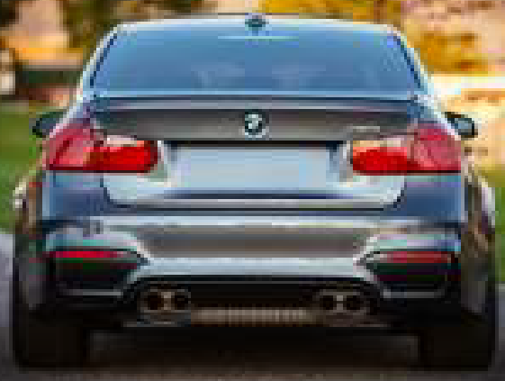
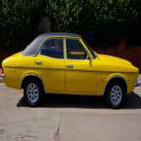


Car detection example
Training set:
x | y
 | 1
 | 1
 | 1
 | 0
 | 0

Slide 14
Sliding windows detection

Slide 15
Object Detection
Convolutional implementation of sliding windows

Slide 16
Convolutional implementation of sliding windows
The sliding windows object detection algorithm involves cropping small image regions and feeding them to a ConvNet for predictions. However, the computational cost, especially with fine granularity, is high.
To address this, fully connected layers can be converted to 5x5 filters, allowing the use of convolutional layers for improved efficiency.
The convolutional implementation shares computation across the entire image, passing it through the ConvNet with 5x5 filters, followed by max pooling and fully connected layers. This results in a 1x1x4 volume, and using 5x5 filters yields a 2x2x4 volume for each region.
While more efficient, this algorithm may lack precision in bounding box positioning, a concern addressed in the next section.
Notes:
The previous section introduced the concept of sliding windows object detection algorithm. This algorithm inputs an image, crops out small regions from it, and feeds each region to a ConvNet that makes a prediction of whether the region contains the object of interest or not.
However, the computational cost of this approach was found to be too high when using a ConvNet, especially when using a fine granularity.
To solve this problem, the fully connected layers in the neural network can be converted into convolutional layers. This can be achieved by using 5x5 filters, with each filter looking across all channels of the input volume. By implementing fully connected layers as 5x5 filters, each output value in the next layer becomes a linear function of the activations from the previous layer. This enables the use of convolutional layers in place of fully connected layers, which are more computationally efficient.
The convolutional implementation of the sliding windows algorithm involves sharing computation between different regions of the input image. Instead of running the ConvNet sequentially on each cropped region, the entire image can be passed through the ConvNet at once, which makes the prediction of all regions more efficient. The 14x14 image is run through the ConvNet with 5x5 filters, followed by max pooling and then fully connected layers, before being passed through a softmax activation function to get the final output of the ConvNet. This output is a 1x1x4 volume. By using 5x5 filters in the ConvNet, the output volume becomes a 2x2x4 volume after applying the 1x1 filters. The four outputs of this volume correspond to the output of running the ConvNet on each of the four 14x14 regions of the input image.
The weakness of this algorithm is that the position of the bounding boxes is not very accurate. This problem will be addressed in the next section.

Slide 17
Turning FC layer into convolutional layers
MAX POOL
FC
⋮
FC
⋮
5 × 5
2 × 2
y
softmax (4)
14 × 14 × 3
10 × 10 × 16
5 × 5 × 16
400
400
MAX POOL
FC
FC
5 × 5
2 × 2
5 x 5
1 x 1
14 × 14 × 3
10 × 10 × 16
5 × 5 × 16
1 x 1 x 400
1 x 1 x 400
1 × 1 × 4

Slide 18
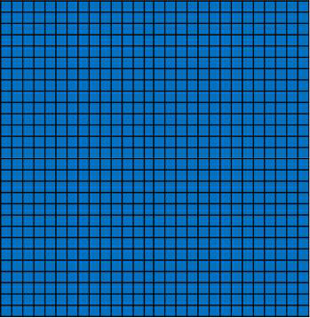
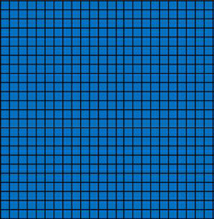
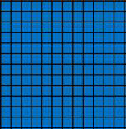
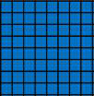
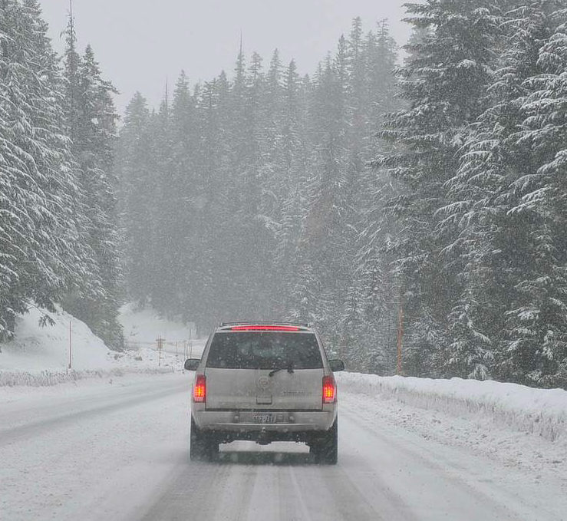
Convolution implementation of sliding windows
MAX POOL
2×2
5×5
5×5
1×1
1×1
28×28
16×16
12×12
8×8×400
8×8×400
8×8×4

Slide 19
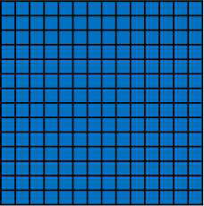
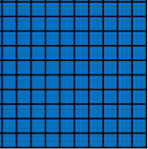
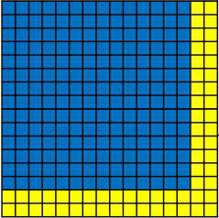
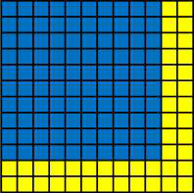

Convolution implementation of sliding windows
^{MAX POOL} FC
2×2 5×5
FC
FC
5×5
1×1
1×1
14×14 ×3
10×10×16
5×5×16
1×1×400
1×1×400
1×1×4
MAX POOL
FC
FC
FC
5×5
2×2
5×5
1×1
1×1
16×16×3
12×12×16
6×6×16
2×2×400
2×2×400
2×2×4
MAX POOL
2×2
5×5
5×5
1×1
1×1
28×28×3
24×24×16
12×12×16
8×8×400
8×8×400
8×8×4

Slide 20
Object Detection
Bounding box predictions

Slide 21
Bounding box predictions
The YOLO (You Only Look Once) algorithm enhances bounding box prediction accuracy by dividing the image into a grid and applying classification and localization to each cell.
Each cell is assigned an 8-dimensional vector, including object presence probability, bounding box coordinates (BX, BY, BH, BW), and class probabilities (C1, C2, C3, etc.).
Training involves passing the input image through convolutional and max pool layers to produce a 3 by 3 by 8 output volume, aligning with target labels. YOLO encodes bounding box coordinates using a convention relative to the grid cell. Its efficiency lies in convolutional implementation, allowing shared computation for real-time object detection.
While the YOLO paper can be complex, improvements beyond its presented parameterization are explored in the following sections.
Notes:
The YOLO (You Only Look Once) algorithm is an object detection algorithm that is more accurate in predicting bounding boxes compared to sliding window methods. The basic idea of YOLO is to divide the input image into a grid and apply an image classification and localization algorithm to each of the cells in the grid. For each cell, a label Y is specified, which is an 8-dimensional vector that includes the probability of an object being present, the bounding box coordinates (BX, BY, BH, BW), and class probabilities (C1, C2, C3, etc.). The midpoint of each object is used to assign the object to a particular grid cell.
To train the neural network, an input image X is passed through the network, which consists of convolutional and max pool layers, to produce a 3 by 3 by 8 output volume. The target labels Y are also 3 by 3 by 8, and the neural network is trained to map from the input image to the target output volume using backpropagation. At test time, the neural network outputs precise bounding boxes for each of the objects in the image.
To encode the bounding box coordinates, YOLO uses a convention that specifies the position of the bounding box relative to the grid cell. BX and BY are between 0 and 1 and specify the position of the midpoint of the bounding box, while BH and BW are fractions that specify the height and width of the bounding box relative to the grid cell. There are multiple ways to specify the bounding boxes, and YOLO uses a convention that works reasonably well.
The YOLO algorithm is efficient because it is a convolutional implementation, which allows for shared computation between all the computations needed for the cells in the grid. This makes it suitable for real-time object detection. However, the YOLO paper can be difficult to understand, and there are other parameterizations that work better than the one presented in the paper. The next few section will show additional ideas to make the YOLO algorithm even better.

Slide 22
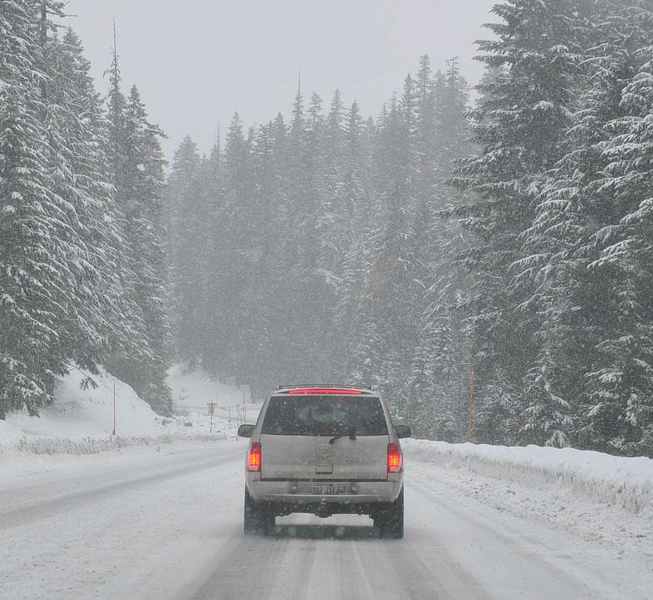
Output accurate bounding boxes

Slide 23
YOLO algorithm
Labels for training For each grid cell:
100

Slide 24
Object Detection
Intersection over union

Slide 25
Intersection over union
Intersection over Union (IoU) assesses object detection accuracy by evaluating the overlap between predicted and ground-truth bounding boxes.
The IoU is computed as the intersection area divided by the union area, producing a value from 0 to 1, where 1 indicates perfect overlap.
A threshold, commonly 0.5, determines the correctness of the predicted bounding box.
Adjusting the threshold allows for more stringent evaluation.
IoU is versatile, serving not only as an evaluation metric for object detection algorithms but also as a tool to measure bounding box similarity, as discussed further in the next section on non-max suppression.
Notes:
Intersection over Union (IoU) is a function used to evaluate the accuracy of an object detection algorithm. In object detection, you are not only expected to identify the object but also to localize it.
The ground-truth bounding box is the actual location of the object, and the algorithm should output a bounding box that overlaps with it.
The IoU function computes the intersection over union of these two bounding boxes, where the intersection is the common region between the two boxes, and the union is the total area covered by both boxes. The IoU is calculated by dividing the intersection area by the union area. The IoU value ranges from 0 to 1, where 1 indicates a perfect overlap, and 0 means no overlap.
By convention, a threshold of 0.5 is used to judge whether the predicted bounding box is correct or not. If the IoU is greater than or equal to 0.5, the answer is considered correct. However, you can use a different threshold, such as 0.6 or 0.7, to be more stringent. The higher the IoU, the more accurate the bounding box.
IoU is not only used to evaluate object detection algorithms but also to measure the similarity between two bounding boxes. The next section will cover non-max suppression, which is a tool used to improve the outputs of YOLO (You Only Look Once) object detection algorithm.

Slide 26
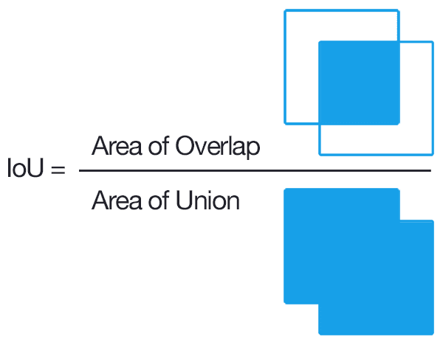
Evaluating object localization
“Correct” if IoU ≥ 0.5
More generally, IoU is a measure of the overlap between two bounding boxes.

Slide 27
Object Detection
Non-max suppression

Slide 28
Non-max supperssion
Non-max suppression ensures object detection algorithms identify each object only once.
1. Assigning a probability (Pc) to each predicted bounding box, boxes below a threshold are discarded.
2. Boxes with the highest Pc values are highlighted, and overlapping boxes are suppressed based on Intersection over Union (IoU).
3. This process repeats until all boxes are either predicted or suppressed.
Applied independently to each class's output, non-max suppression enhances accuracy by eliminating duplicates and reducing false positives in object detection algorithms.
Notes:
Non-max suppression is a technique used to ensure that an object detection algorithm detects each object only once, even if it detects the same object multiple times. The first step in non-max suppression is to assign a probability, Pc, to each bounding box predicted by the algorithm. Then, the boxes with Pc less than or equal to a certain threshold are discarded.
Next, the boxes with the highest Pc values are repeatedly selected and highlighted as predicted object detections. Any remaining boxes with high overlap, measured by IoU, with the highlighted boxes are suppressed and darkened. This process continues until all boxes have either been highlighted as a predicted detection or darkened as a suppressed detection.
If multiple objects are being detected, non-max suppression is carried out independently on each class's output. The technique can be applied using a simple grid or with anchor boxes, which will be discussed in the next section.
Overall, non-max suppression helps ensure that object detection algorithms produce more accurate results by eliminating duplicate detections and reducing false positives.

Slide 29
Non-max suppression example
Andrew Ng

Slide 30
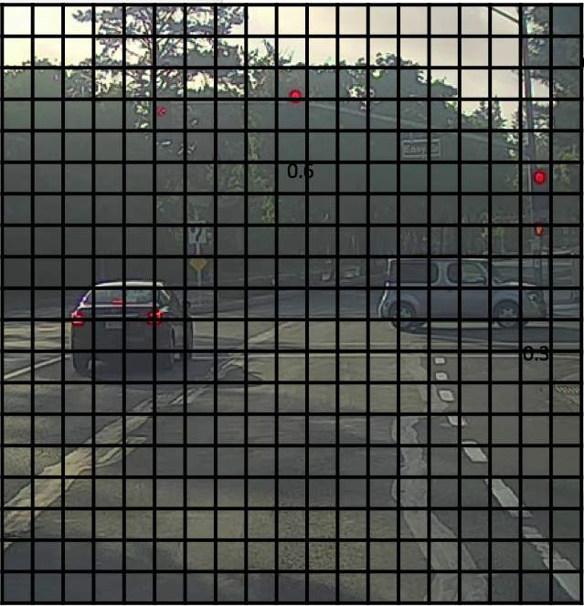
Non-max suppression example

Slide 31
Non-max suppression example
0.6
0.8
0.9
0.7
0.7

Slide 32
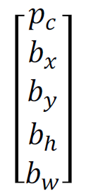
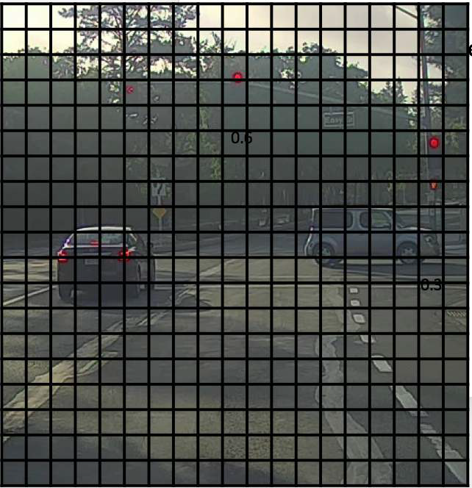

Non-max suppression algorithm
Each output prediction is:
Discard all boxes with $% ≤ 0.6
While there are any remaining boxes:
Pick the box with the largest
Output that as a prediction.
Discard any remaining box with IoU ≥ 0.5 with the box output in the previous step
19×19

Slide 33
Object Detection
Anchor boxes

Slide 34
Anchor boxes
Anchor boxes in object detection enable each grid cell to detect multiple objects, overcoming the limitation of one object per cell.
By pre-defining anchor box shapes and associating predictions based on the highest Intersection over Union (IoU) with the object's shape, the YOLO algorithm encodes objects in a 16-dimensional vector.
This method allows specialization for various object types, such as tall or wide objects.
Anchor boxes can be selected manually or through a K-means algorithm, providing versatility in object shape detection.
Notes:
Anchor boxes are a technique used in object detection to allow each grid cell to detect multiple objects.
The problem with object detection using grid cells alone is that each grid cell can only detect one object. Anchor boxes solve this problem by pre-defining two or more shapes called anchor box shapes. These shapes can be used to associate two predictions with two anchor boxes. Each object is assigned to the same grid cell as before but is assigned to a grid cell and anchor box pair with the highest IoU with the object's shape. This way, the object gets encoded in the target label with a 16-dimensional vector, or an 8-dimensional vector with two anchor boxes.
The YOLO algorithm assigns the object to a grid cell and anchor box pair that contains the object's midpoint. If there are two objects with the same midpoint, this algorithm may have a tiebreaker to resolve the conflict. However, this is not a common occurrence, especially with larger grids like 19 by 19. Anchor boxes allow the learning algorithm to specialize better and detect different types of objects like tall, skinny objects and white, fat objects.
Choosing anchor boxes can be done by hand, selecting a variety of shapes that reasonably expands the set of object shapes you expect to detect. Another way is to use a K-means algorithm to group together two types of object shapes you tend to get and select a set of anchor boxes that are most stereotypically representative of the object causes you're trying to detect.

Slide 35
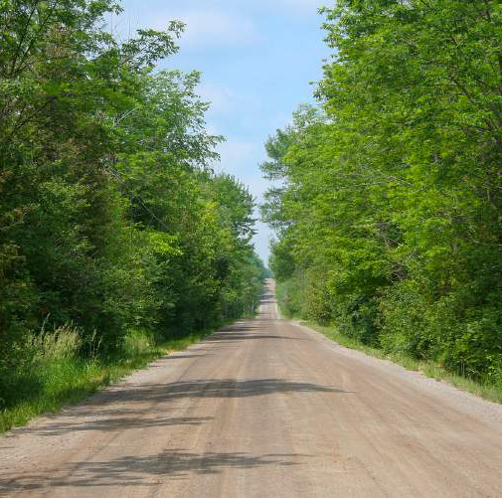


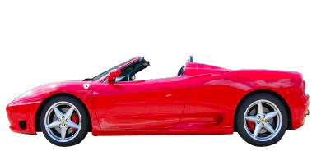



Overlapping objects:
Anchor box 1:
Anchor box 2:
y =

Slide 36
Anchor box algorithm
Previously:
Each object in training image is assigned to grid cell that contains that object’s midpoint.
With two anchor boxes:
Each object in training image is assigned to grid cell that contains object’s midpoint and anchor box for the grid cell with highest IoU.

Slide 37
Object Detection
Region proposals (Optional)

Slide 38
Region proposals (Optional)
In object detection, region proposals, like those in R-CNN (Regions with Convolutional Neural Networks), select specific windows for algorithm processing instead of evaluating each window individually.
While effective, R-CNN is slow, leading to improvements like Fast R-CNN and Faster R-CNN, employing convolutional methods. An alternative is the YOLO (You Only Look Once) algorithm, processing the entire image at once for direct object detections.
Understanding region proposals is key, but ongoing research aims to develop more efficient object detection algorithms without relying on region proposals.
Notes:
In the context of object detection, region proposals are a set of ideas that have been influential in computer vision. The idea behind region proposals is to select just a few windows, or regions, on which to run the object detection algorithm, instead of running it on every single window in the image. The R-CNN (Regions with Convolutional Neural Networks) algorithm is an example of a region proposal algorithm that uses a segmentation algorithm to identify potential objects in the image and then selects those regions for further processing.
However, the R-CNN algorithm is slow because it processes each proposed region independently. To address this issue, there have been improvements to the R-CNN algorithm, such as the Fast R-CNN algorithm, which uses a convolutional implementation of sliding windows, and the Faster R-CNN algorithm, which uses a convolutional neural network to propose regions.
While region proposals have been influential in computer vision, some researchers believe that a more promising direction for object detection is to be able to do everything at the same time, without having to propose regions first. This is the approach taken by the YOLO (You Only Look Once) algorithm, which processes the entire image at once and generates object detections directly.
Overall, understanding region proposals is important for understanding other object detection algorithms that may use this idea. However, there is ongoing research into developing more efficient and effective algorithms that can perform object detection without the need for region proposals.

Slide 39
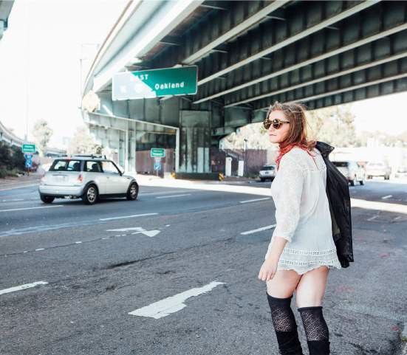
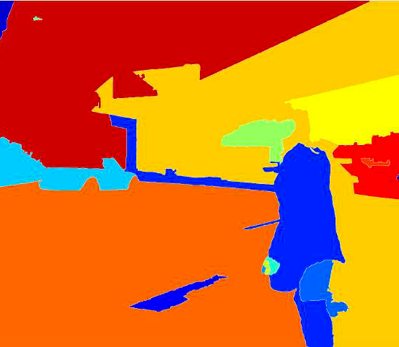
Region proposal: R-CNN

Slide 40

Anchor box example
y =
Anchor box 1:
Anchor box 2:

Slide 41
Object Detection
Putting it together: YOLO algorithm

Slide 42
Putting it together: YOLO algorithm
The YOLO (You Only Look Once) object detection algorithm is a popular and effective algorithm that encompasses many of the best ideas in computer vision related to object detection.
To train the YOLO algorithm, you need to construct a training set with explicit labels for the three classes you want to detect (pedestrians, cars, and motorcycles) and a background class. If you use two anchor boxes, the output y will be 3 by 3 by 2 by 8 or 3 by 3 by 16. For each of the nine grid cells in the training set, you form the appropriate target vector y, specifying whether there is an object there and its class, along with its bounding box. You train a convolutional neural network (ConvNet) on this training set, with an input image (e.g., 100 by 100 by 3) and an output volume (e.g., 3 by 3 by 16).

Slide 43
Putting it together: YOLO algorithm
To make predictions, the neural network outputs a 3 by 3 by 2 by 8 volume, with each grid cell having a vector specifying whether there is an object there, its class, and its bounding box:
Run non-max suppression on the predicted bounding boxes to eliminate low-probability predictions and to eliminate overlapping predictions for the same object.
Run non-max suppression for each of the classes (pedestrians, cars, and motorcycles) to generate the final predictions.
The YOLO algorithm is one of the most effective object detection algorithms, and you get to practice implementing many of its components in this week's problem exercise.

Slide 44
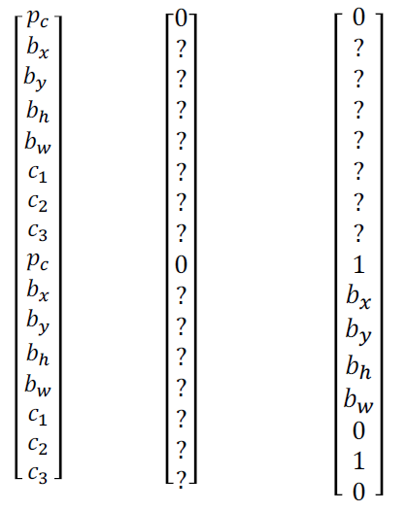
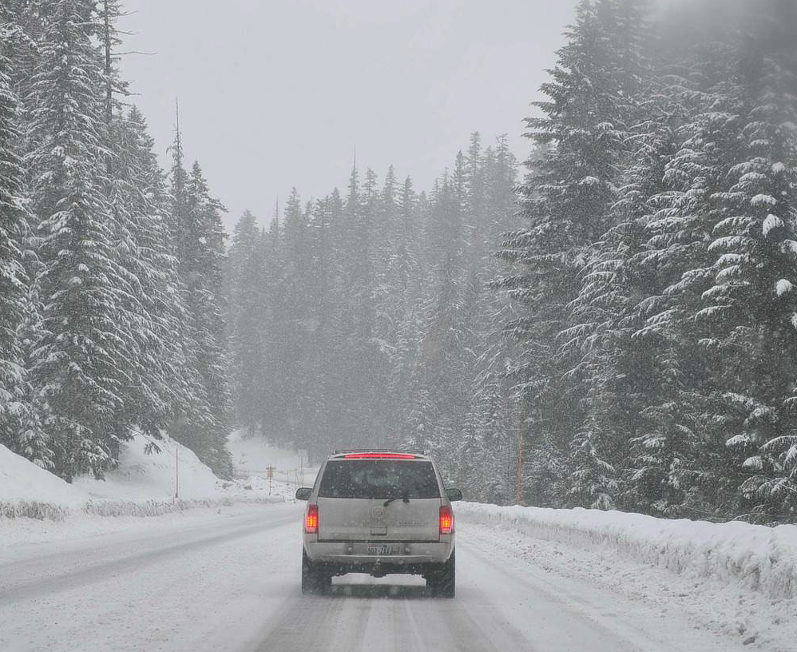
Training
- pedestrian
- car
- motorcycle
y
=
y is 3×3×2×8

Slide 45
Making predictions
⋯
y =
3×3×2×8

Slide 46
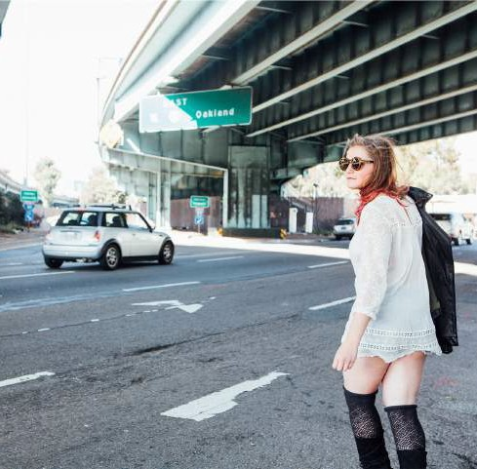
Outputting the non-max supressed outputs
For each grid cell, get 2 predicted bounding boxes.
Get rid of low probability predictions.
For each class (pedestrian, car, motorcycle) use non-max suppression to generate final predictions.

Slide 47
Faster algorithms
R-CNN:
Propose regions. Classify proposed regions one at a time. Output label + bounding box.
Fast R-CNN:
Propose regions. Use convolution implementation of sliding windows to classify all the proposed regions.
^{Faster R-CNN:} Use convolutional network to propose regions.

Slide 48
Convolutional Neural Networks
Semantic segmentation with U-Net

Slide 49
Semantic segmentation with U-Net
Semantic segmentation, distinct from object detection, labels each pixel in an image to determine object presence. Applied in various domains like self-driving cars and medical imaging, it relies on algorithms outputting a matrix of class labels for every pixel.
The unit architecture, a convolutional neural network, employs transpose convolutions to expand activations and label each pixel.
Semantic segmentation is crucial in computer vision applications, including medical imaging, self-driving cars, and object recognition.
Notes:
While object detection identifies the position of objects in an image, semantic segmentation aims to label every single pixel in the image, determining which pixels belong to the object and which ones do not.
Semantic segmentation can be used in many commercial applications, such as self-driving cars, medical imaging, and brain tumor detection.
In order to label every pixel in an image, a learning algorithm needs to output a whole matrix of class labels, which is quite different from the class label or the class label with bounding box coordinates typically generated by object detection algorithms.
The unit architecture is a convolutional neural network architecture that can be used for semantic segmentation. This architecture gradually blows up a small set of activations to a bigger set of activations, labeling every single pixel in the image. To achieve this, the unit architecture uses an operation called the transpose convolution, which is a key step in making the image bigger.
Overall, semantic segmentation is a very useful algorithm for many computer vision applications where it is important to identify every single pixel in the image, such as in medical imaging, self-driving cars, and object recognition.

Slide 50
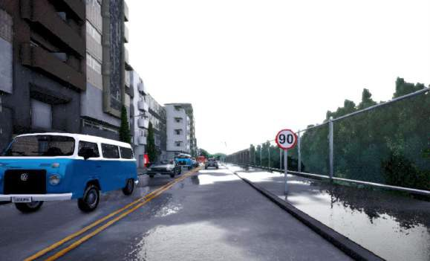
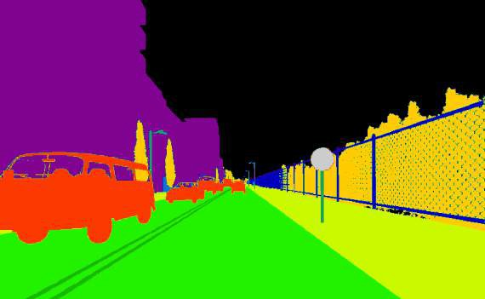
Object Detection vs. Semantic Segmentation
Input image
Object Detection
Semantic Segmentation

Slide 51
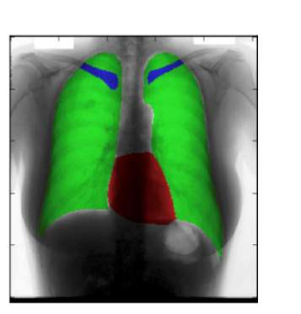
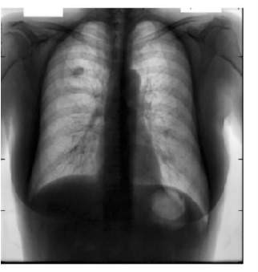
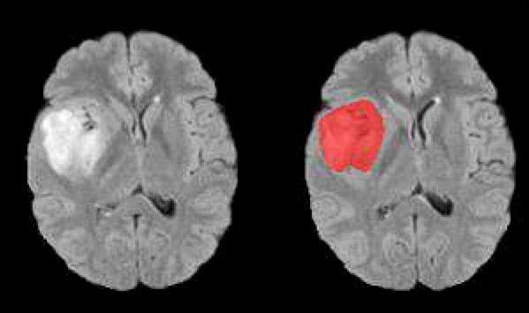
Motivation for U-Net
Chest X-Ray
Brain MRI

Slide 52
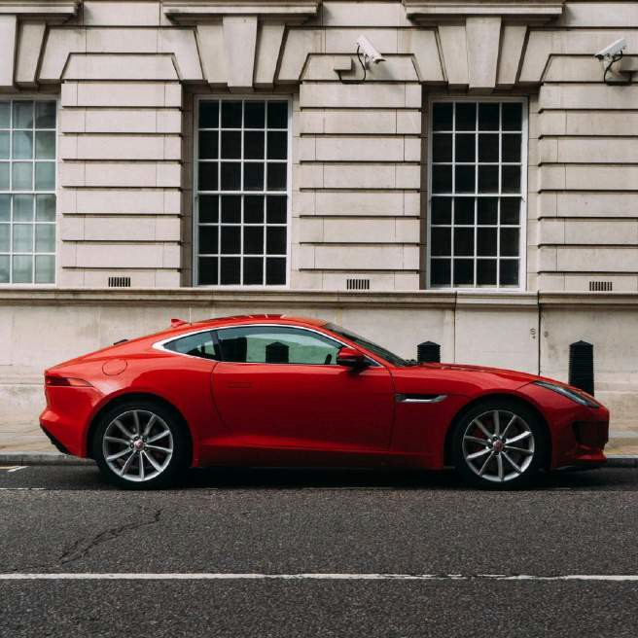
Per-pixel class labels
0 0 0 0 0 0 0 0 0 0 0 0 0 0 0 0 0 0 0 0 0 0 0 0
0 0 0 0 0 0 0 0 0 0 0 0 0 0 0 0 0 0 0 0 0 0 0 0
0 0 0 0 0 0 0 0 0 0 0 0 0 0 0 0 0 0 0 0 0 0 0 0
0 0 0 0 0 0 0 0 0 0 0 0 0 0 0 0 0 0 0 0 0 0 0 0
0 0 0 0 0 0 0 0 0 0 0 0 0 0 0 0 0 0 0 0 0 0 0 0
0 0 0 0 0 0 0 0 0 0 0 0 0 0 0 0 0 0 0 0 0 0 0 0
0 0 0 0 0 0 0 0 0 0 0 0 0 0 0 0 0 0 0 0 0 0 0 0
0 0 0 0 0 0 0 0 0 0 0 0 0 0 0 0 0 0 0 0 0 0 0 0
0 0 0 0 0 0 0 1 1 1 1 1 1 0 0 0 0 0 0 0 0 0 0 0
0 0 1 1 1 1 1 1 1 1 1 1 1 1 1 1 ⁰ ⁰ ⁰ ⁰ ⁰ ⁰ ⁰ ⁰
0 0 1 1 1 1 1 1 1 1 1 1 1 1 1 1 1 1 1 1 1 1 1 0
0 0 1 1 1 1 1 1 1 1 1 1 1 1 1 1 1 1 1 1 1 1 1 ⁰
0 0 0 0 1 1 1 0 0 0 0 0 0 0 0 0 0 0 1 1 1 0 0 0
0 0 0 0 0 0 0 0 0 0 0 0 0 0 0 0 0 0 0 0 0 0 0 0
0 0 0 0 0 0 0 0 0 0 0 0 0 0 0 0 0 0 0 0 0 0 0 0
0 0 0 0 0 0 0 0 0 0 0 0 0 0 0 0 0 0 0 0 0 0 0 0
0 0 0 0 0 0 0 0 0 0 0 0 0 0 0 0 0 0 0 0 0 0 0 0
1. Car
0. Not Car

Slide 53
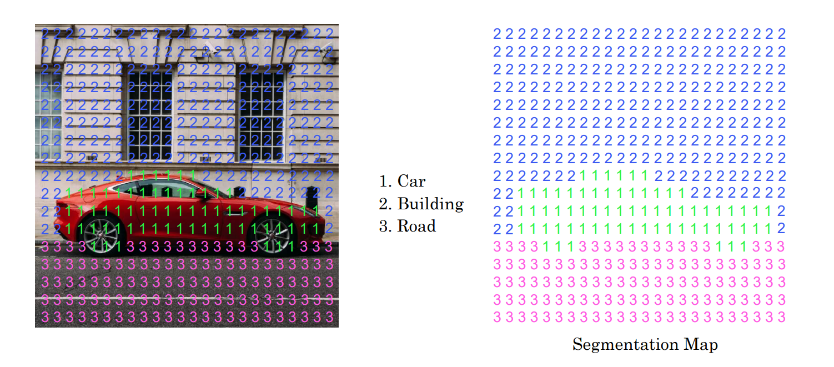
Per-pixel class labels

Slide 54
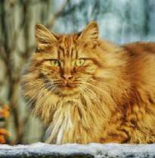
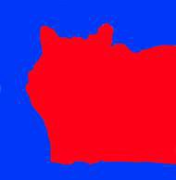
Deep Learning for Semantic Segmentation

Slide 55
Convolutional Neural Networks
Transpose Convolution

Slide 56
Transpose Convolution
Transpose convolution is a crucial element in the unit architecture for semantic segmentation, employed to enlarge a small input into a larger output.
Unlike regular convolution where the filter is applied to the input, in transpose convolution, the filter is positioned on the output.
For instance, using a 3x3 filter with padding p=1 and stride s=2 on a 2x2 input creates a 4x4 output. Each entry in the input matrix illustrates the filter application, resulting in a 4x4 output matrix.
This operation is fundamental in the unit architecture for gradually expanding feature maps in semantic segmentation until the final segmentation map is achieved.
Notes:
The concept of transpose convolution is a key part of the unit architecture used in semantic segmentation. Transpose convolution is used to take a small input and blow it up into a larger output.
Compare regular convolution and transpose convolution:
- In regular convolution, a filter is placed on top of the inputs and is convolved to generate an output.
- In transpose convolution, instead of placing the filter on the input, a filter is placed on the output.
To illustrate how transpose convolution works, consider an example of taking a 2x2 input and blowing it up into a 4x4 output. A 3x3 filter is chosen with padding p=1 and stride s=2. The input is then multiplied by the filter and the output is pasted in the appropriate position.
Each entry in the input matrix, showing how the filter is applied and how the output is generated. The result is a 4x4 output matrix that is the result of the transpose convolution operation.
ranspose convolution is a key building block of the unit architecture used in semantic segmentation. The unit architecture uses transpose convolution to gradually blow up the feature maps until the final segmentation map is generated.

Slide 57
Transpose Convolution
Normal Convolution
*
=
Transpose Convolution
=
*

Slide 58
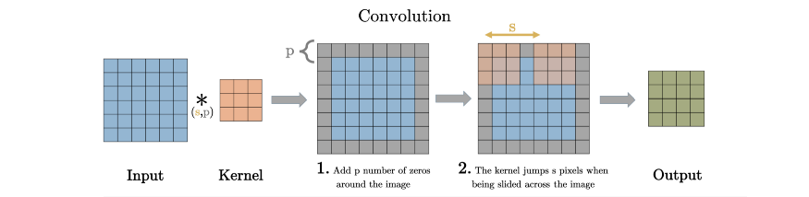
Transpose Convolution
²3₂¹ | ²3₂¹ | ²3₂¹
1 | 2 | 1
²3₂¹ | ²3₂¹ | ²3₂¹
2 | 0 | 1
²3₂¹ | ²3₂¹ | ²3₂¹
0 | 2 | 1
 | ₀0 | 2₄+2 | ₀0 | ₁1
 | 4¹⁺⁰⁶ | ² +₇0 +3⁺² | ²₆+4 | 1 ₃⁺²
 | ₀0 | ³₇+4 | ₀0 | ₂2
 | ₆6 | 3₃+0 | ₄4 | ₂2
2 | 1
3 | 2

Slide 59
Deep Learning for Semantic Segmentation
Skip connection
𝑦ො

Slide 60
U-Net Architecture Intuition
The neural network for semantic segmentation involves initial convolutions for compression and spatial reduction, followed by transpose convolutions to restore the image size.
Adding skip connections, as in the unit architecture, significantly enhances network performance.
These connections provide the final layer with both high-level spatial/contextual information and low-level texture details for more accurate segmentation decisions.
Notes:
The architecture of the neural network used for semantic segmentation involves normal convolutions in the first half of the network to compress the image and reduce spatial information. The second half of the network then uses transpose convolutions to blow the representation size back up to the size of the original input image.
However, adding skip connections from the earlier layers to the later layers, as in the unit architecture, can significantly improve the performance of the network.
The reason for this is that the final layer of the network needs both high-level, spatial, and contextual information (which is obtained from the earlier layers) as well as low-level, fine-grained, texture-like information (which is lost in the earlier layers due to compression). By adding skip connections, the neural network can take advantage of both the high-level and low-level information to make more accurate decisions about whether a certain pixel is part of a cat or not, for example.

Slide 61
U-Net Architecture
U-Net, a convolutional neural network for semantic segmentation in computer vision, comprises an encoder and a decoder.
The encoder has convolutional layers reducing spatial dimensionality and increasing channels, while the decoder has transposed convolutional layers for spatial expansion.
Unique skip connections between the encoder and decoder enable the use of both high-level and low-level information in segmentation decisions.
U-Net is widely used in biomedical image segmentation and other tasks like road segmentation and object detection, known for its distinctive U-shaped architecture.
Notes:
The U-Net architecture is a type of convolutional neural network that is commonly used for semantic segmentation tasks in computer vision. The architecture consists of two parts: an encoder and a decoder. The encoder part of the network is made up of several convolutional layers that reduce the spatial dimensionality of the input image while increasing the number of channels. The decoder part of the network consists of several transposed convolutional layers that increase the spatial dimensionality of the image while decreasing the number of channels.
The skip connections between the encoder and decoder parts of the network are what make the U-Net architecture unique. These connections allow the network to use both high-level and low-level information when making segmentation decisions. The skip connections copy the output from an earlier layer of the encoder and concatenate it with the output from the corresponding decoder layer. This provides the decoder with high-resolution features and low-resolution contextual information, allowing the network to make more accurate segmentation decisions.
The U-Net architecture is commonly used for biomedical image segmentation, but it has also been applied to other types of image segmentation tasks, such as road segmentation and object detection. The U-Net architecture is named for its U-shaped architecture, which resembles a U when visualized.

Slide 62
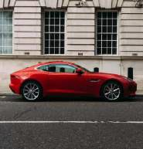
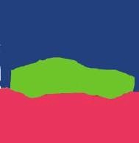





U-Net
Conv, RELU Max Pool Trans Conv
Skip Connection Conv (1x1)

Slide 63
U-Net
h x w x 3
h x w x # classes
Conv, RELU Max Pool Trans Conv
Skip Connection Conv (1x1)

Slide 64
Summarization
Object localization predicts a bounding box for an object, while landmark detection identifies specific points on it.
Object detection combines localization and classification for multiple objects.
Convolutional sliding windows efficiently implement this using CNNs.
Bounding box predictions use regression to predict coordinates.
IoU measures detection accuracy by evaluating overlap.
Non-max suppression removes redundant and low-confidence boxes. Anchor boxes, pre-defined bounding boxes, enhance accuracy.
YOLO (You Only Look Once) is a real-time object detection algorithm.
Semantic segmentation classifies each pixel using the U-Net architecture.
Region proposals generate potential object locations for detection refinement.
Notes:
Object Localization: Locating an object in an image by predicting a bounding box.
Landmark Detection: Identifying specific points on an object, such as facial features.
Object Detection: Combining localization and classification for multiple objects in an image.
Convolutional Sliding Windows: Efficiently implementing sliding windows using convolutional neural networks.
Bounding Box Predictions: Using regression techniques to predict bounding box coordinates.
Intersection over Union (IoU): Evaluating object detection accuracy by measuring overlap.
Non-Max Suppression: Removing redundant and low-confidence bounding boxes.
Anchor Boxes: Pre-defined bounding boxes improving object detection accuracy.
YOLO Algorithm (You Only Look Once): Real-time object detection predicting boxes and class probabilities in a single pass.
Semantic Segmentation with U-Net: Classifying each pixel in an image using the U-Net architecture.
Region Proposals (Optional): Generating potential object locations for subsequent detection refinement.

